Slide 1
Treatment Visualization
Depth Estimation of Melanoma Skin Lesions through Explainable AI and Hologram Generation
Notes:
Topic for my research is an application of the Treatment Visualization Case Study. We want to use it for the depth estimation of the melanoma skin lesions

Slide 2

Outline
Introduction: Problem Statement, Case Study
Key Literature
Methodology: ML + XAI
Methodology: 3D Hologram Generation
Results and Conclusion
Future Work
References
Notes:
I shall start by introducing the problem statement and the case study.
I shall then discuss four important studies that were essential in the development of this research.
The methodology is divided into two segments: one with ML +XAI, the other with 3D Hologram generation
And finally…..

Slide 3
Introduction
Malignant skin cancer is the multiplication of infected cells on the skin and into the body tissue.
Malignant skin cancer comprises 5 stages, where the 4th and 5th stages are fatal if not detected early.
Global warming and the depletion of the ozone layer has increased exposure to UV rays, causing a steep rise in the number of melanoma cases over the past decade.
Treatment Visualization: A proposed framework where we integrate Vision and XR for a particular use case.
We would like to use it to estimate the depth of a malignant skin lesion.
Notes:
After 1st point: The initial or surface stage is called nevus, while if the cancer grows beneath the surface, it is considered melanoma.
Why have you not included Treatment Visualization? It was a proposed framework in an earlier study we conducted. It has not been included here since it initially used segmentation of the infected tissue instead of depth estimation. It would be confusing.
Our key contribution: To estimate the depth of a malignant skin lesion beneath the skin, which has not been done before

Slide 4

Key Literature
“Towards Enhancing Extended Reality for Healthcare Applications with Machine Learning” – For the Case Study (2023) [1]
“Melanoma is skin deep: a 3d reconstruction technique for computerized dermoscopic skin lesion classification.” – For information on melanoma and skin lesion depth (2017) [2]
“Grad-cam: Why did you say that?” – For XAI component (2016) [3]
“Defocus map estimation from a single image.” – For estimating depth from a single image (2011) [4]
Notes:
The first paper was the initial study performed by us that had the proposed framework.
The second paper was the first study to propose the estimation of a lesion’s depth through depth maps and surface reconstruction. However, our method of generating the 3D structure is different and more precise.
The third paper introduces Grad-CAM which is the XAI algorithm used in the study.
Since we have a single image per lesion in our dataset (top-view of the lesion), we use the depth from defocus method.

Slide 5
Methodology: ML + XAI
We get the probability of a lesion being malignant to categorize its severity.
Dataset Used: Processed skin cancer images from the ISIC archive
Slightly unbalanced with 1497 malignant and 1800 benign images.
Each image has a shape (224, 224, 3) with RGB channels.
Notes:
A higher percentage means a higher stage of malignancy, thereby detecting melanoma.
Why is it slightly unbalanced? This is because it will develop a slight bias towards the benign class. This makes it a bit harder for the model to classify the malignant case. This reduces the number of FP cases (Cases that are malignant but detected as benign).

Slide 6
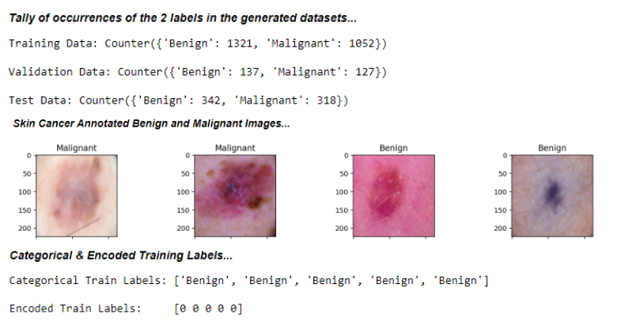
Dataset Preprocessing
Notes:
Perform the split into training, validation, and test data. Validation is used to tune the hyperparameters of the model (alpha of the gradient descent, regularization term), and the testing data gives us the evaluation metrics (accuracy, precision, recall, etc.). We use train test split in sklearn for the same.
Perform Annotation for clarity
It is easier to train the model on encoded training labels. We use the LabelEncoder in sklearn for the same

Slide 7
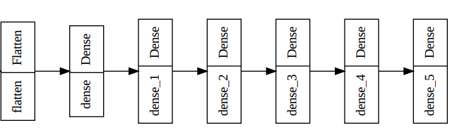
Model
Model Used: Baseline pre-trained VGG19 with a functional model on top.
VGG19 weights are pre-trained on the standard ImageNet dataset.
The functional model uses Flatten on the base model output and performs hierarchical feature reduction with 6 Dense layers.
Notes:
The pre-trained VGG19 is present in the tensorflow.keras.applications library. It is a state-of-the-art, classic architecture that is commonly used for image classification
The functional model is created layer-by-layer using tensorflow.keras.layers like Flatten and Dense
Why pre-trained VGG19: We use it due to its architecture design and since it is well trained over the ImageNet dataset. Since our dataset is not the largest, we benefit from not training such a huge model from scratch. It reduces complexity and the training time significantly. It also helps reduce overfitting since the model is generalized to a standard dataset.
Why 6 Dense layers? To perform hierarchical feature reduction. After we use Flatten, we have too many features from the base model. We need to decrease them step-by-step until we have two features, 0 or 1, the output of the model.

Slide 8
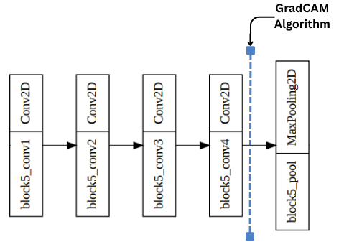
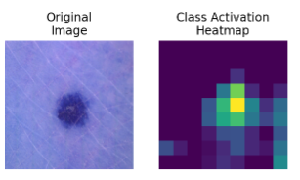
GradCAM algorithm
An intrinsically implemented XAI technique to localize the essential parameters of an image.
GradCAM's role is to highlight the image area responsible for the said output. (Segmentation of sorts)
It creates a localized mapping depicting the essential features and is used after the last convolution layer of the model.
Notes:
We perform mathematical operations on tensors, according to its algorithm.
An extrinsically implemented XAI technique does not make changes within the model, and it is used as an external tool. Example: The Labelbox framework allows us to visualize the inner alterations during model optimization. They are easy to manipulate
Intrinsic: As you can see, there are changes in the model. Other Example: CAM, attention layers. They could reduce the performance of the model and increase complexity

Slide 9
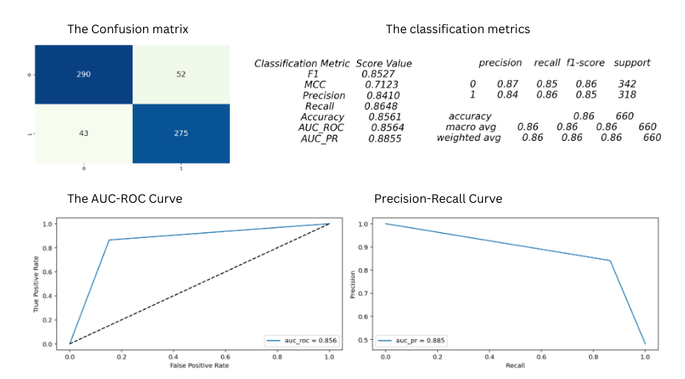
Model Results
The Evaluation metrics are calculated on the testing data
Notes:
An MCC Score of 0.7123 indicates a strong positive correlation between the model predictions and class labels.
Precision: The ratio of positive class with total positive predictions (TP/ TP + FP)
Recall: The ratio between positive class with total positive samples (TP/ TP + FN)
AUC-ROC represents the area under the FP and TP curve, which are important parameters when the dataset is slightly imbalanced.
There is a slight trade-off with the evaluation metrics when we use an intrinsic XAI technique.

Slide 10
Methodology: 3D Hologram Generation
3-step procedure:
Estimating depth from defocus occurrence: Used for depth map estimation from a singular image
3D structure representation of the depth: Using Gabor filters
Conical Representation of the structure: Done through red spot analysis
Notes:
1. The depth map depends on the lesion’s color, texture, and width. A darker color gives a darker depth in that area

Slide 11
Depth from defocus occurrence
Used when we have one image/angle of a particular scene
Input: GradCAM gives us a blended image with the localization of our lesion
Canny Edge Detection gives us the edges (boundaries) of the localized image.
We apply Gaussian Blur for smoothing and getting a coherent depth map as our output
We apply the defocus method (using an alpha component) between the edge and blur to get an entire depth map as the output.
Notes:
We have the top view for each lesion in the dataset
Canny Edge Detection using the cv2.Canny. Gaussian Blur using cv2.GaussianBlur. Compute the defocus occurrence between the two using cv2.magnitude
Alternate method: The “shape from shading” method analyzes variations in color across the image.

Slide 12
3D Structure Representation
A few important hyperparameters | Values
Orientations of Gabor filters | 0, pi/4, pi/2, 3*pi/4 (4 in number)
Frequency | For 0 and 90 degrees, 0.1 (finer details), and for the other two 0.4 (coarser details)
Sigma Value | 0.01 for a sharper pixelated output
Size | (5,5) usually a commonly used size
Gamma Value | 0.5 for finer texture representation
We use Gabor filters for the same.
Input: Depth map after defocus occurrence.
We use the getGaborKernel function of the cv2 library; we need to tune its hyperparameters effectively.
Notes:
1. Explain the selected orientations

Slide 13
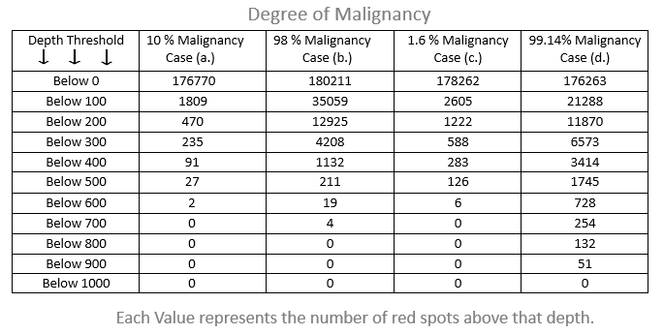
Conical Representation
The primary goal is to use these red-spot numbers (infected areas) to create a conical structure.
Each value is considered as a base of the cone
The first column tells us the depth units beneath the skin, where 0 represents the skin’s surface
The other columns indicate the number of red spots beneath that depth value.
A malignant lesion will have a higher volume of lesions and proceed deeper into the skin.
Notes:
Please explain how the red spot analysis leads to the conical structure: We take each value as the base of the cone. We get multiple cones representing the conical structure of the lesion.
In between Cases (a) and (c): It would be wrong to map the degree of malignancy directly with the red-spot analysis like that. The probability of malignancy is an output of the CNN model, which predicts using the training data, and it does not have a direct relation to the red spots that we get from the depth map. All we are using the red spots for is to give the lesion a conical structure to estimate its depth within the skin.

Slide 14
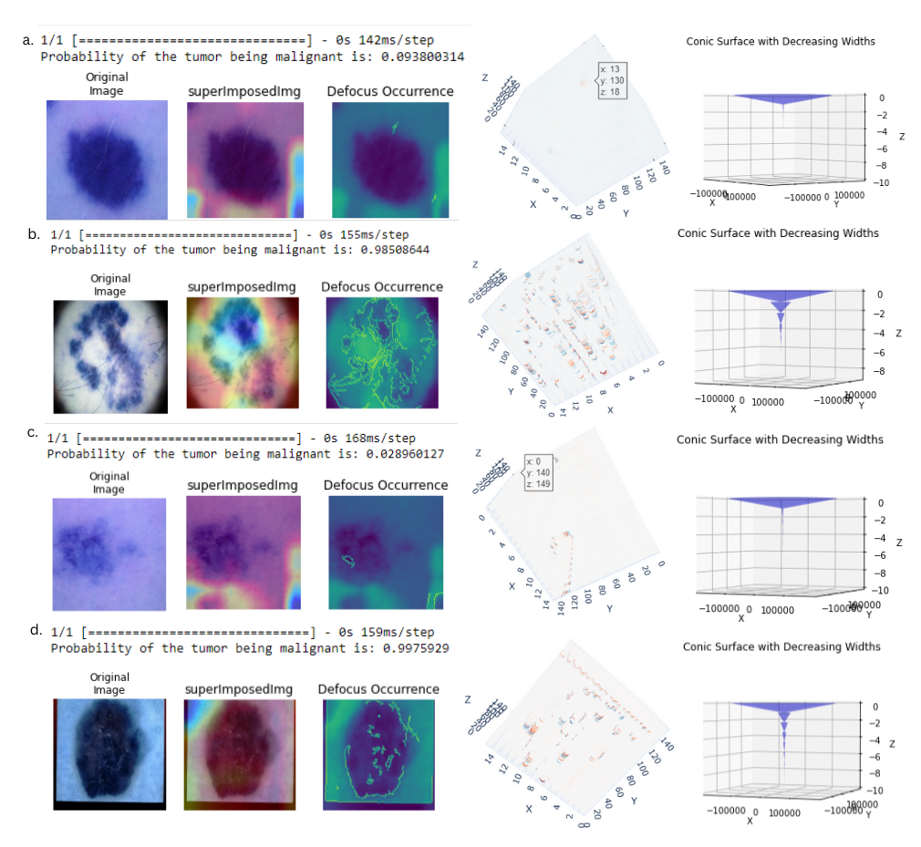
Results
Original Image: The input image of the skin lesion
superImposedImg: The image after GradCAM is applied
Defocus Occurrence: Depth map of the output from GradCAM.
The Cube: Represents the 3D structure representation after the Gabor filters have been used
Conic Surface: The Depth of the lesion is displayed as a conical structure after red spot analysis. This is visualized through the MR headset for a detailed analysis
Notes:
Q. Why are we considering the degree of malignancy, was’nt this a classification problem? When we use a CNN, our final output is a probability. The probability of Case (a) being a malignant lesion is 9.38%, therefore making it of benign nature.

Slide 15
Conclusions from the Result
The neural model gives us satisfactory value for all evaluation metrics, despite a Class Activation Map layer being present.
There may have been a mild increase in these values because of the XAI manipulations.
Benign lesion (Case a and c) | Malignant lesion (Case b and d)
Does not have a significant defocus boundary. | Does have a defocus boundary.
Due to the lack of the boundary, it is mildly covered by red spots. | Due to the presence of a boundary difference in depth, it has greater red spots.
The Conic Structure is not very deep and has few fractions. | The conic structure is deeper and has more fractions compared to the other case.
Notes:
Almost all Evaluation values in between 85 and 90 percent, with the accuracy being 86 percent.

Slide 16
Future Work
To USE THE CONCEPT OF TREATMENT VISUALIZATION FOR OTHER HEALTH CASES
Evaluation of the generated holograms by a physician for a real-world application
Evaluation of generated holograms from a technical standpoint: fidelity and validity
Notes:
Focus on the evaluation portion

Slide 17
References
P. Parekh and R. Oyeleke. In Towards Enhancing Extended 605 Reality for Healthcare Applications with Machine Learning. 606 AIVR [Manuscript in Preparation], 2023.
T. Y. Satheesha, D. Satyanarayana, M. G. Prasad, and K. D. 586 Dhruve. Melanoma is skin deep: a 3d reconstruction tech- 587 nique for computerized dermoscopic skin lesion classifica- 588 tion. IEEE journal of translational engineering in health 589 and medicine, 5:1–17, 2017.
R. R. Selvaraju, A. Das, R. Vedantam, M. Cogswell, 667 D. Parikh, and D. Batra. Grad-cam: Why did you say that?. 668 arxiv. In preprint, 2016.
S. Zhuo and T. Sim. Defocus map estimation from a single 688 image. Pattern Recognition, 44(9):1852–1858, 2011.

Slide 18
Thank you
Pranav Parekh

